Slide 1
SCHEDULING GA

Slide 2
Scheduling GA
Scheduling Problem
A special class of optimization problems, in which not only the position of different elements but also their order and adjacency are important.
Example: TSP
Symmetrical Scheduling Problem:
d_{ij} = d_{ji}

Slide 3
Two types of TSP:
Fully-connected TSP and
Partially-connected Asymmetrical TSP

Slide 4
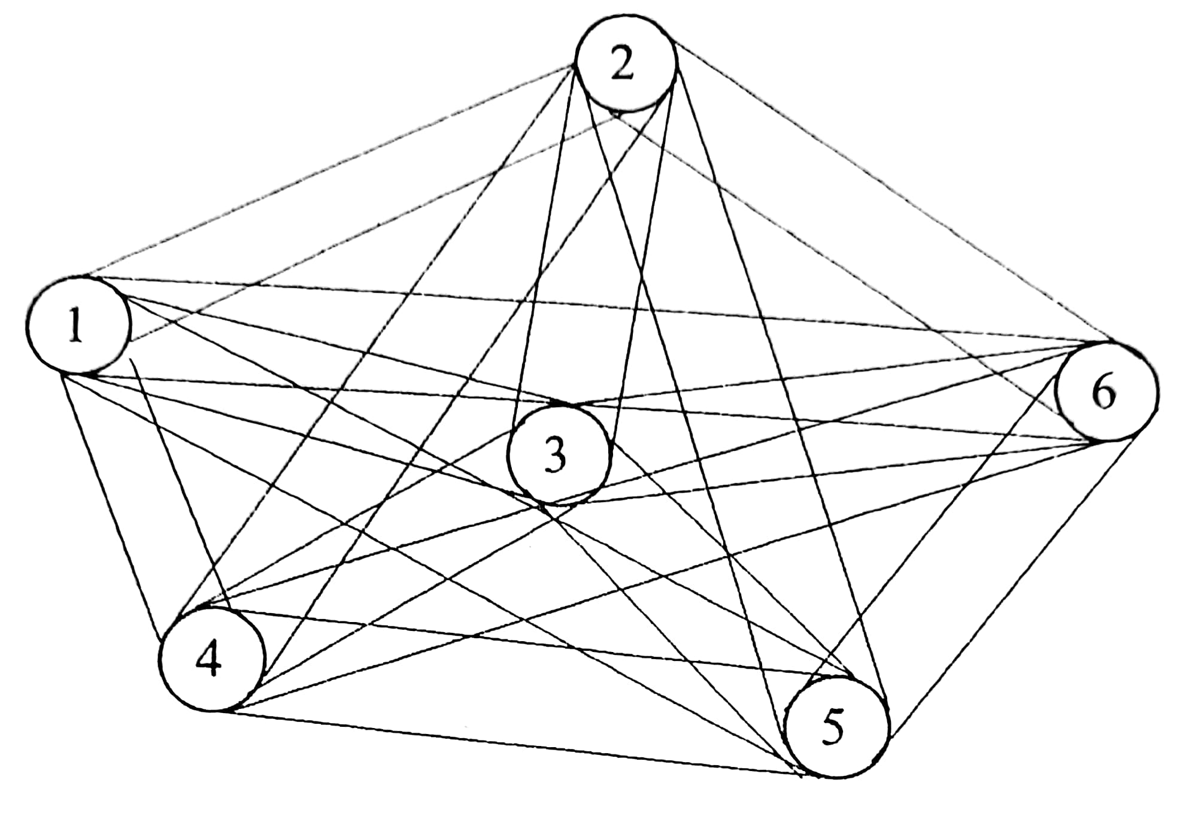
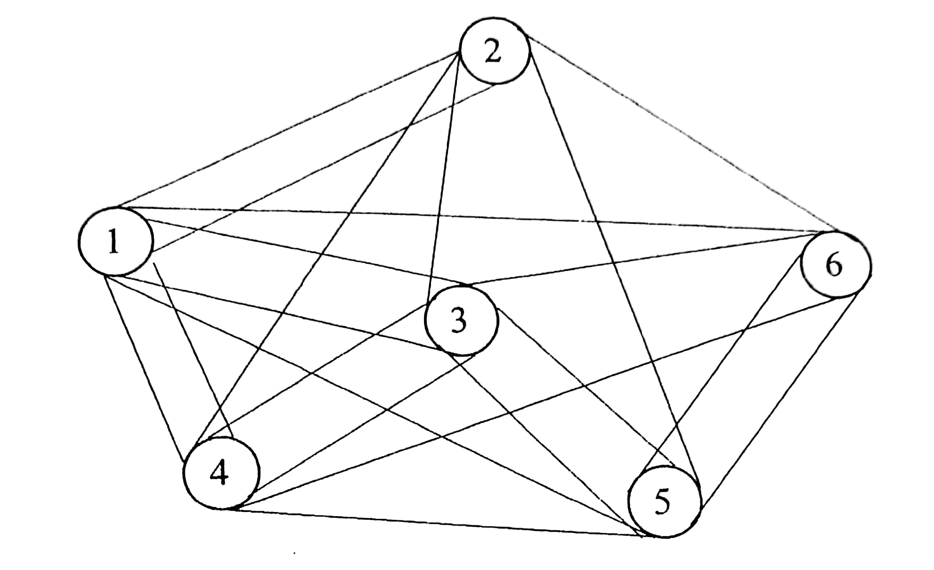
Fully-Connected TSP
II. Partially-Connected Asymmetrical TSP

Slide 5
In TSP involving n cities, there is a maximum of n! possible sequences
SGA with conventional crossover operators may not be suitable for the scheduling problems

Slide 6
Some Specialized Crossover Operators
Edge Recombination
Proposed by Whitley et al. (1991)
Let us consider a TSP involving nine cities
Pr₁: 1 2 3 4 5 6 7 8 9
Pr₂: 9 3 1 4 5 8 2 6 7

Slide 7
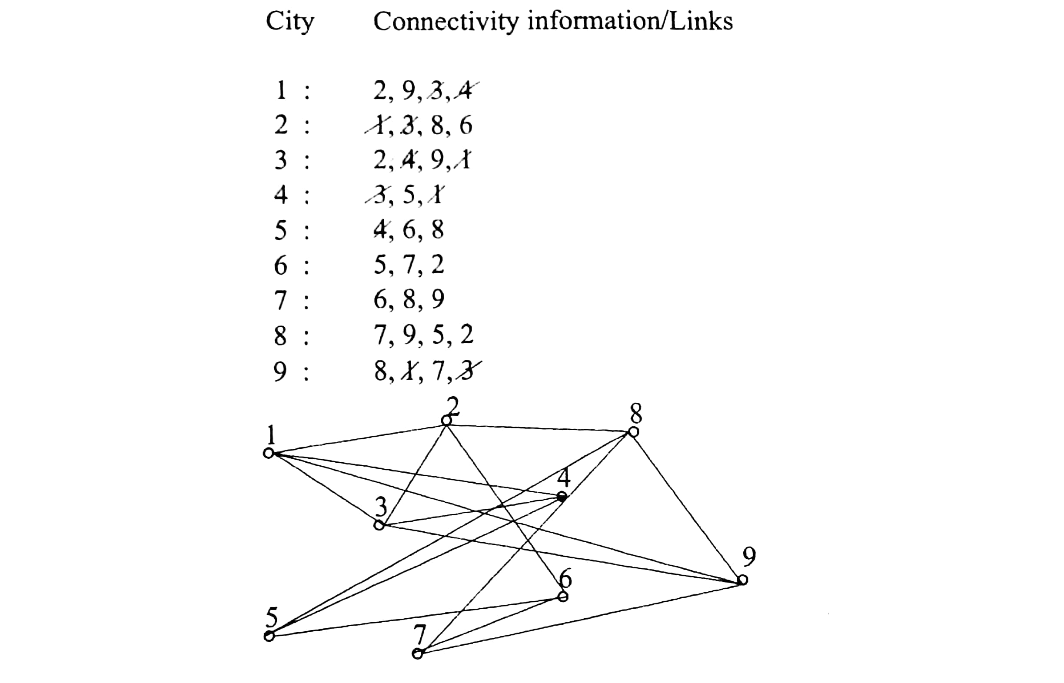
Edge table

Slide 8
Procedure
Let us start the child tour with the starting city of Pr₁, that is, 1
As city 1 has been selected, all occurrences of 1 are to be deleted from the right-hand side of edge table
City 1 is connected to the cities: 2,3,4 and 9. Now, the cities: 2,3 and 9 have three remaining connectivities each in the edge table, whereas city 4 has only two remaining links. Thus, 4 is selected as the next city to city 1

Slide 9
We eliminate all entries of city 4 from the right-hand side of edge table
Now, city 4 has the links to the cities 3 and 5. Now, both the cities 3 and 5 have two remaining links in the edge table. Thus, any one out of the cities: 3 and 5 may be selected at random. Let us select 3 as the next city to city 4.
We remove all entries of city 3 from the right-hand side of edge table
We continue this process, until the tour is completed after touching all the cities once.

Slide 10
We get
Ch₁: 1 4 3 2 6 5 8 7 9
Similarly, starting with city 9 of Pr₂, we get
Ch₂: 9 7 6 5 8 2 1 3 4

Slide 11
2. Order Crossover
Proposed by Davis (1985)
A part of one child solution is obtained by copying directly from a part of one parent and the other part of that child inherits the order of remaining elements of other parent.
Let us consider the following two parents:
Pr₁: 1 2 3 4 5 6 7 8 9
Pr₂: 3 4 5 1 2 9 8 7 6
* *

Slide 12
Procedure
Select two crossover sites at random
To obtain child 1, the elements: 1,2,9,8 (lying between two crossover sites) are directly copied from Pr₂, keeping their locations and order intact

Slide 13
Child 1 tour then begins from Pr₁, starting from the first position after the second crossover site and searching towards the initial elements of Pr₁.
We get
Ch₁: 5 6 7 (1 2 9 8) 3 4
similarly
Ch₂: 2 9 8 (4 5 6 7) 3 1

Slide 14
3. Cycle Crossover
Proposed by Oliver et al. (1987)
Absolute positions of elements of a parent are preserved while determining a child solution
Let us consider the following two parents:
Pr₁: 1 2 3 4 5 6 7 8 9
*
Pr₂: 3 4 5 1 2 9 8 7 6

Slide 15
Procedure
To determine Ch₁, select a parent (say Pr₁) and the starting position of the cycle (say 3rd) at random.
Thus, ch₁[3] = 3
Pr₂ is then searched to check the presence of element 3 and it has been found in the first position.
Thus, Ch₁[1] = Pr₁[1] =1

Slide 16
Pr₂ is again searched for a presence of element 1 and it has occurred at 4th position.
Thus, Ch₁[4] = Pr₁[4] = 4
Similarly, we get
Ch₁[2] = Pr₁[2] = 2,
Ch₁[5] = Pr₁[5] = 5,
This completes the cycle.

Slide 17
The remaining elements of Ch₁ are directly selected from Pr₂
Ch₁[6] = Pr₂[6] = 9
Ch₁[7] = Pr₂[7] = 8
Ch₁[8] = Pr₂[8] = 7
Ch₁[9] = Pr₂[9] = 6
We get
Ch₁: 1 2 3 4 5 9 8 7 6
Ch₂: 3 4 5 1 2 6 7 8 9

Slide 18
4. Position-Based Crossover
Introduced by Syswerda (1991)
To preserve position information of different parent elements in the child solution
Let us consider two parents as given below
Pr₁: 1 2 3 4 5 6 7 8 9
* * * *
Pr₂: 3 4 5 1 2 9 8 7 6

Slide 19
Procedure
To determine Ch₁, choose a number of crossover points (say 1st, 4th, 7th and 9th) on Pr₁. The elements: 1,4,7 and 9 are directly copied from Pr₁ (by keeping their position information intact to ch₁. Thus, we get
Ch₁[1] = 1
Ch₁[4] = 4
Ch₁[7] = 7
Ch₁[9] = 9

Slide 20
The remaining elements of Ch₁ are selected from Pr₂
Ch₁[2] = 3
Ch₁[3] = 5
Ch₁[5] = 2
Ch₁[6] = 8
Ch₁[8] = 6
We get
Ch1: 1 3 5 4 2 8 7 6 9
Similarly,
Ch2: 3 2 4 1 5 7 8 9 6

Slide 21
5. Partially Mapped Crossover (PMX)
Proposed by Goldberg and Lingle (1985)
A part of a parent solution lying between two crossover sites is directly copied into a child solution
Let us consider the following two parents:
Pr₁: 1 2 3 4 5 6 7 8 9
Pr₂: 3 4 5 1 2 9 8 7 6
* *

Slide 22
Procedure
Select two crossover sites at random
The elements: 4, 5, 6, 7 of Pr₁ (lying within, two crossover sites) are directly copied into Ch₁. Thus, we get
Ch₁[4] = 4
Ch₁[5] = 5
Ch₁[6] = 6
Ch₁[7] = 7

Slide 23
To determine the remaining elements of Ch₁, the search starts with the elements of Pr₁ residing in between the two crossover sites. The element Pr₁[4] = 4 is located at 2nd position of Pr₂.
Thus, the 2nd position of Ch₁ will be filled up by an element of Pr₂ located at 4th position, that is, city 1.
Ch₁[2] = Pr₂[4] = 1
Ch₁[3] = Pr₂[5] = 2
Ch₁[9] = Pr₂[6] = 9
Ch₁[8] = Pr₂[7] = 8

Slide 24
The remaining element of Ch₁ is directly copied from Pr₂, That is,
Ch₁[1] = Pr₂[1] = 3
Thus, we get
Ch1: 3 1 2 4 5 6 7 8 9
Ch2: 4 5 3 1 2 9 8 7 6

Slide 25
Special case
Pr₁: 1 2 3 4 5 6 7 8 9
Pr₂: 3 4 5 1 2 9 8 7 6
* *
Using the PMX, we get
Ch₁: 5 1 (3 4 5 6) 8 7 9
Ch₂: 4 5 (5 1 2 9) 7 8 6
Modified Children
Ch₁: 2 1 (3 4 5 6) 8 7 9
Ch₂: 4 3 (5 1 2 9) 7 8 6

